Slide 1
Strategic Analysis of Bike-Sharing Demand (2011)
Data Science & Operational Insights for Fleet Management
Presented By- Govind Mishra

Slide 2
Project Objectives :
Understand the primary drivers of bike rental demand.
Analyze the impact of weather and time on user behavior.
Differentiate between casual and registered user needs.
Provide actionable recommendations for dash boarding.

Slide 3
Data Summary & Statistics
Sample Size:
1,000 Hourly Records.
Total Rentals:
58,304.
Average Hourly Rentals
58
Max Load:
249 Bikes (Peak).

Slide 4
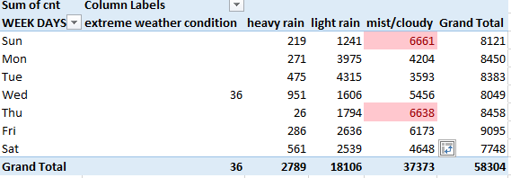
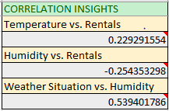
Key Insights & Correlations
Humidity: Negative correlation (-0.25); higher humidity leads to lower demand.
Temperature: Positive correlation (+0.23); warmer weather increases bike usage.
Timing: Peaks occur at 8 AM and 5 PM on workdays, identifying the service as a primary transit solution for commuters.
Weather Conditions: Demand is highest in clear/misty conditions but plummets by 46% during heavy rain.

Slide 5

User Type Breakdown
Registered Users: 53,383 (91.6%) – The core demographic.
Casual Users: 4,921 (8.4%) – Leisure/Weekend focused.
Insight: Member loyalty is high; focus on converting casual users to members

Slide 6
Hourly Rental Trends (Commute Focus)
Working Days: Sharp peaks at 8:00 AM and 5:00 PM.
Holidays/Weekends: More gradual, bell-shaped distribution peaking at mid-day.
Daily Demand Analysis
Comparison of volume across the week (Mon-Sun).
Friday shows the highest average volume (9,095 total for the period).
Working Day Advantage: +41% volume compared to holidays.

Slide 7
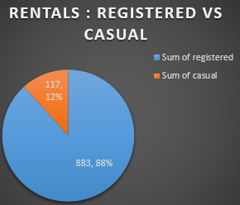

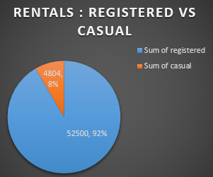
HIGHEST
AVG VOLUME

Slide 8
Environmental Impact
Temperature
Humidity & Wind
Positive correlation (+0.23) between temperature and rentals.
Usage increases consistently as normalized temperatures rise from 0.1 to 0.4.
Humidity: Strong negative impact (-0.25 correlation). Demand drops significantly above 60% humidity.
Wind speed: Minimal impact on the current dataset.

Slide 9
Weather Condition Analysis
Clear/Mist: Highest demand.
Light Rain: Noticeable drop in volume.
Heavy Rain/Extreme: -46% demand drop. Capacity can be diverted or maintenance scheduled during these periods.
Average rentals in "Mist/Cloudy" conditions: ~62
Average rentals in "Heavy Rain": ~33
Conclusion: Weather is the strongest external predictor of daily volume.

Slide 10
Key Performance Indicators (KPIs)
Category | KPI Name | Current Value | Business Insight
Volume | Total Rentals (Count) | 58,304 | Total market demand within the period.
Volume | Max Hourly Load | 249 Bikes | Peak capacity required at your busiest station.
Efficiency | Commute Efficiency | 172 (Avg at 5 PM) | Shows the service's primary value as a transit solution.
Efficiency | Working Day Advantage | +41% Volume | Higher average demand on workdays (58.7) vs. holidays (41.7).
User Type | Member Loyalty Rate | 91.60% | Registered users are the backbone of the business.
User Type | Weekend Tourism Growth | ~1,350 Casual/Day | Casual users are 3x more active on weekends than weekdays.
Weather | Rain Sensitivity | -46% Demand | Drop in average rentals during Heavy Rain vs. Clear/Mist.
Weather | Humidity Impact | -34% Demand | High humidity (>60) significantly reduces bike usage.

Slide 11
Strategic Recommendations
Dynamic Capacity: Increase bike availability during 5 PM peaks on Thursdays , Fridays and sundays.
Incentivize Casuals: Introduce "Weekend Passes" for tourism growth.
Weather Notifications: Use the humidity-demand link to send "Good Weather" alerts to users.
Rainy Day Credits: Offer discounts during heavy rain to offset the 46% demand drop.
Maintenance Windows: Schedule repairs during extreme weather to ensure a 100% available fleet for clear days.
Humidity Nudges: Send push notifications for "Optimal Riding Windows" when humidity is below 60%.
Commuter Points: Reward users who ride both morning and evening peaks with redeemable points.

Slide 12
THANKYOU!

